Slide 1
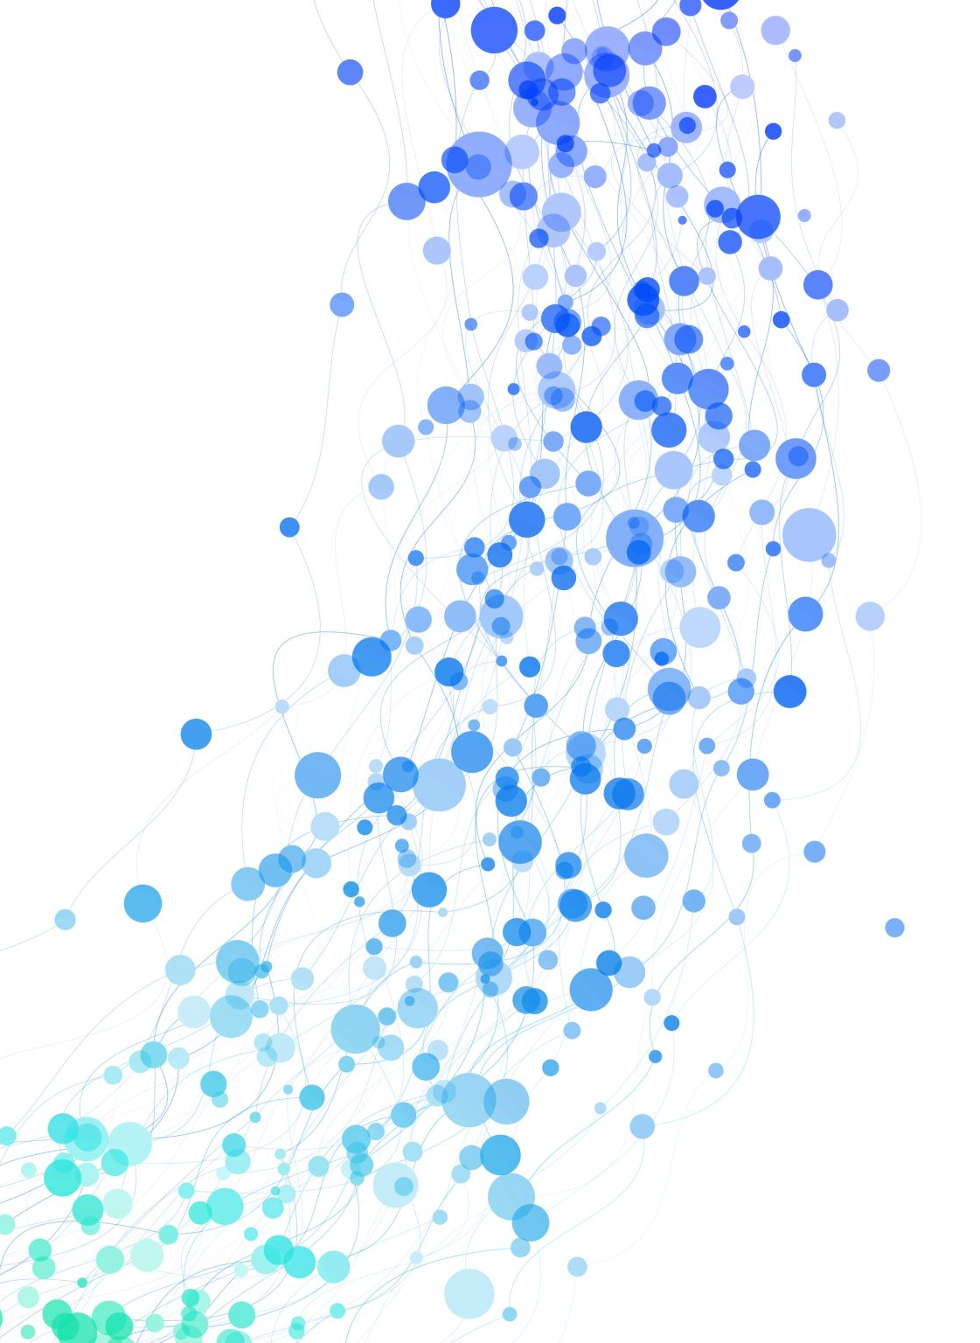
Kaiser Cybersecurity Project
Splunk Visualization for Cyber Attacks
Presented by:
Danae O’Connor & Noah Warren

Slide 2
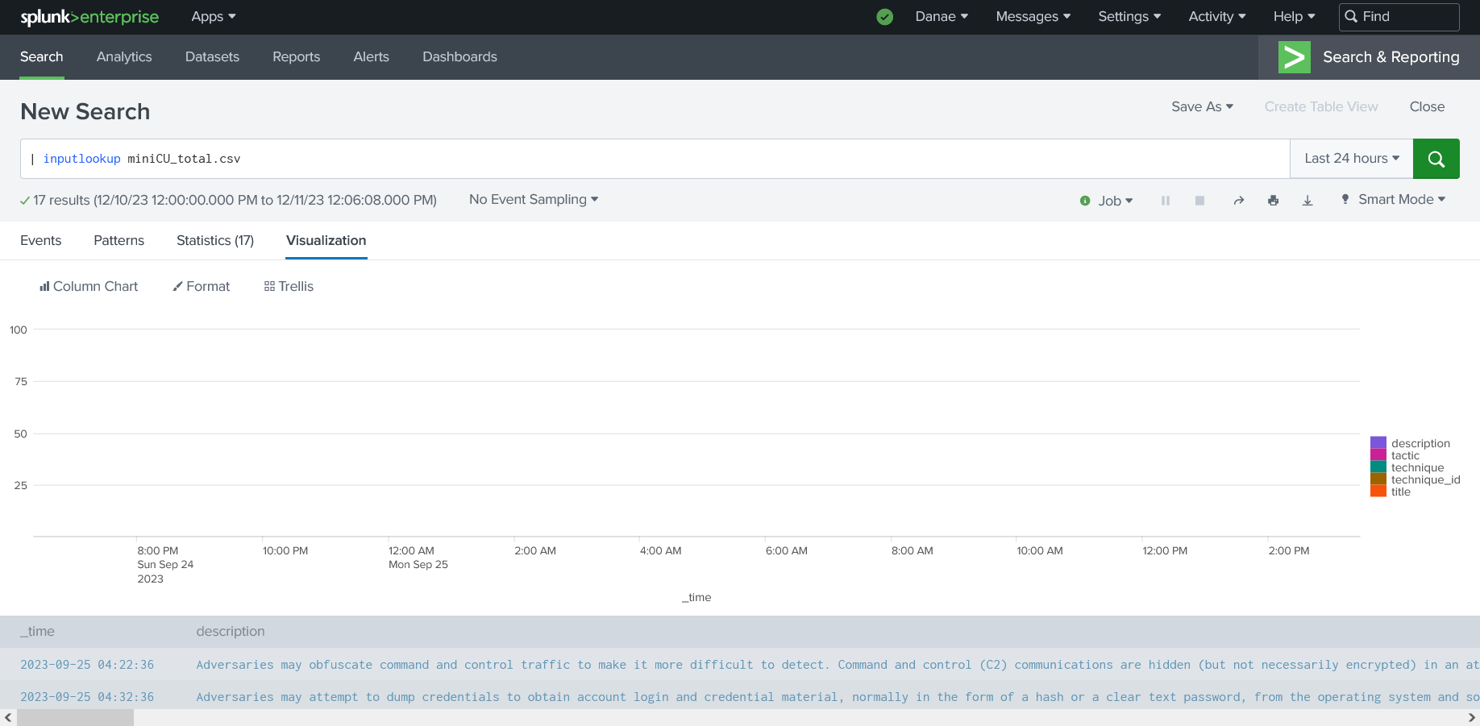
What is the Kaiser Cybersecurity Project?
This project was made to create a visualization tool for Splunk to graph a cybersecurity attack to determine the attack's severity & time

Slide 3

Intended Users of the Product:
Cybersecurity Analysts
&
Those that review how a cyber-attack was conducted
It is expected that these users utilize the Splunk application

Slide 4
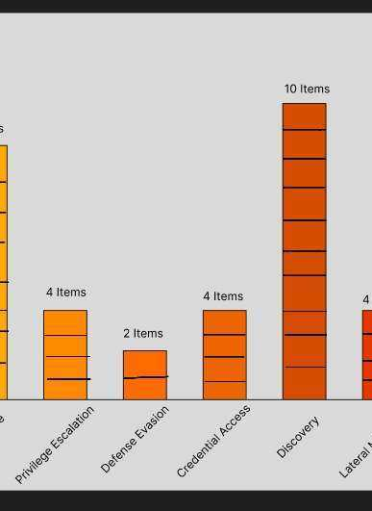
How the project was designed:
We began by gathering requirements
Transitioned into creating initial drawings to generate design ideas & researched Splunk.
Once our designs were confirmed, we then progressed into developing the product.
Using the requirements as a guide, we evaluated the most important aspects of the project.

Slide 5
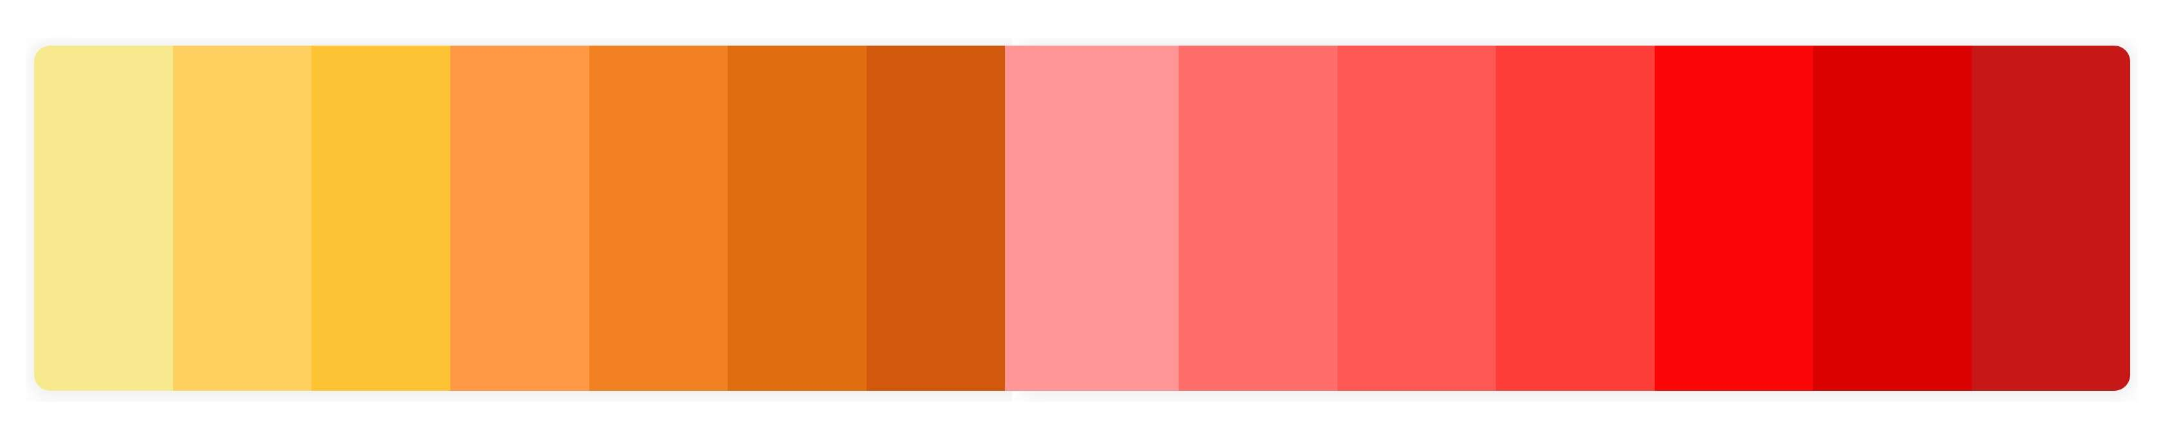
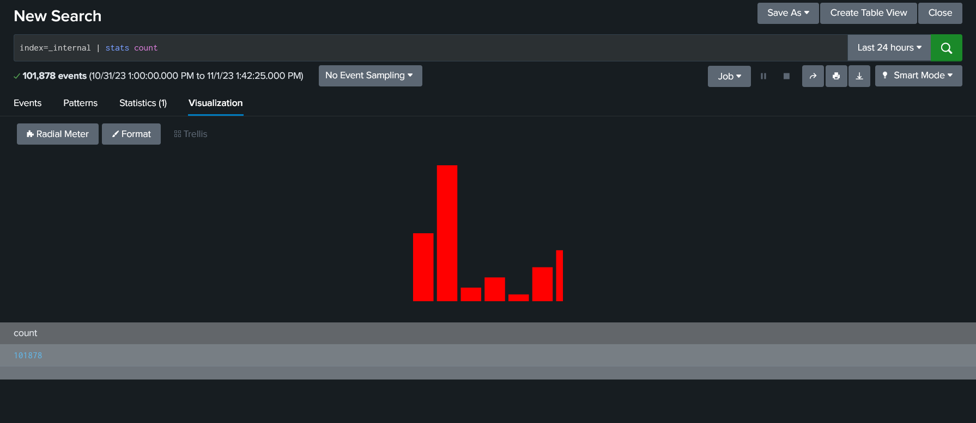
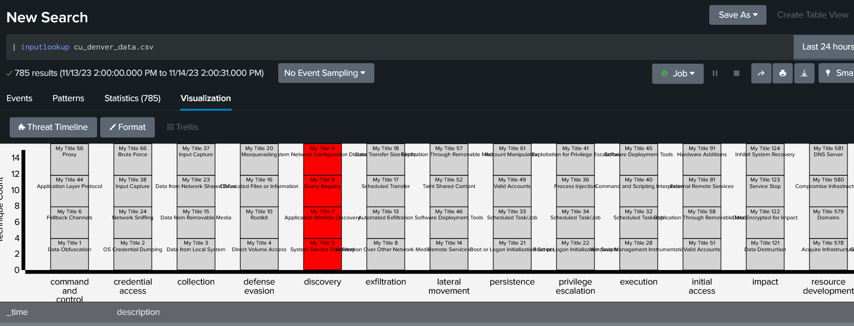
The Design of the Project:
This visualization is created for the Splunk application.
The project is implemented using D3, a JavaScript library for creating dynamic data visualizations.

Slide 6
Benefits of using this product:
Visualize the cyber-attacks made on the system
Determine the severity of the attacks
Understand the details of each attack and their potential effects
Track the timing of each attack

Slide 7
Challenges Leading up to the Prototype
Finding SPLUNK documentation to create visualizations
Data Input Problems.
Graphic Implementation Issues
Debugging Difficulties
Operating System Conflicts​
Merging Versions of product​
Communication Difficulties

Slide 8
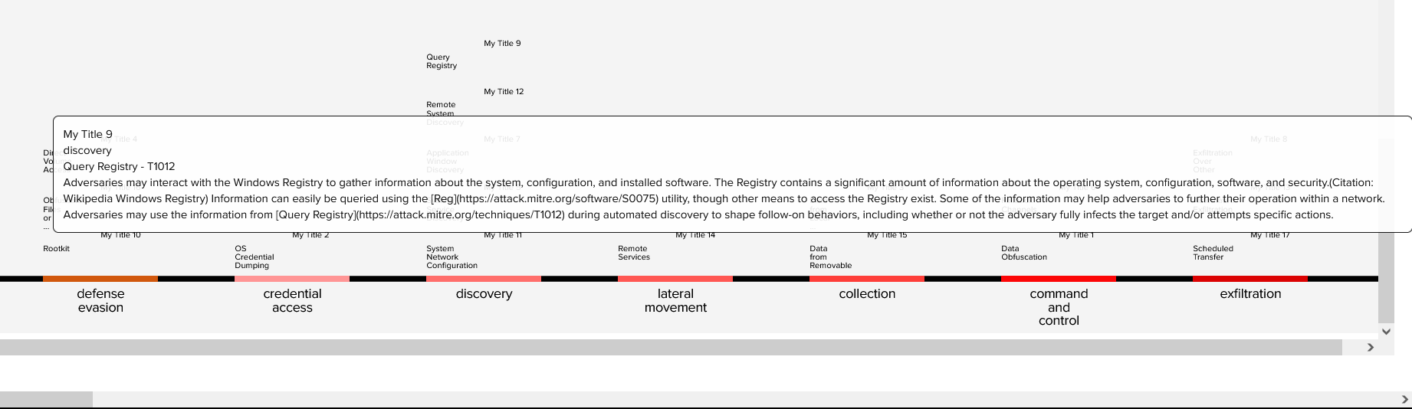
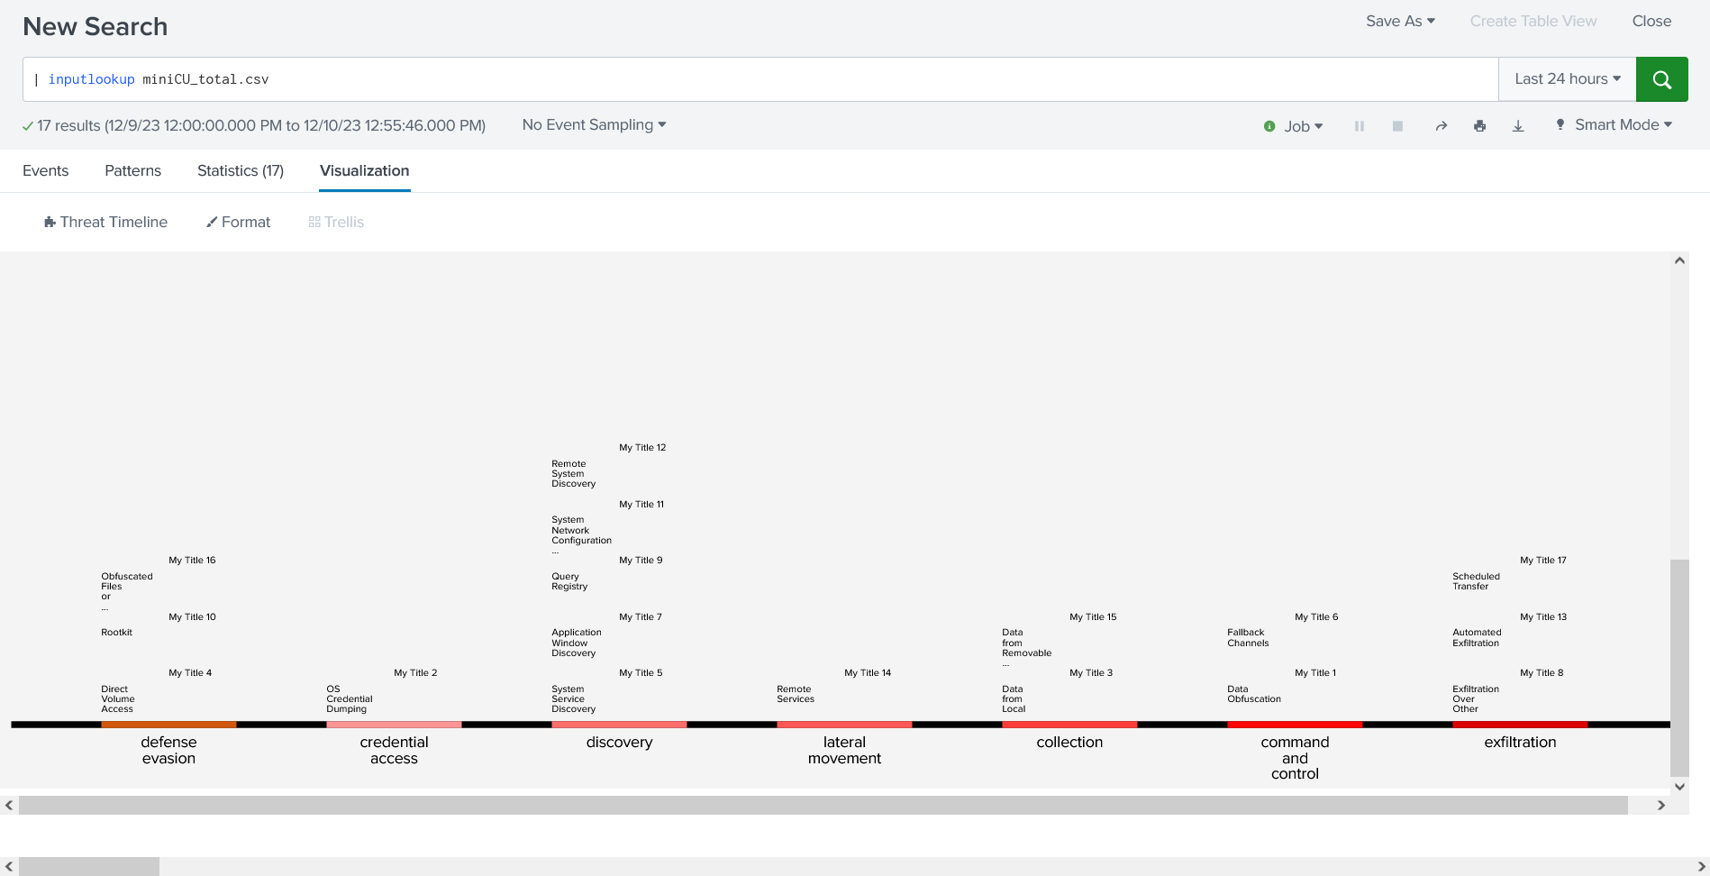
The Prototype: Tactic View

Slide 9
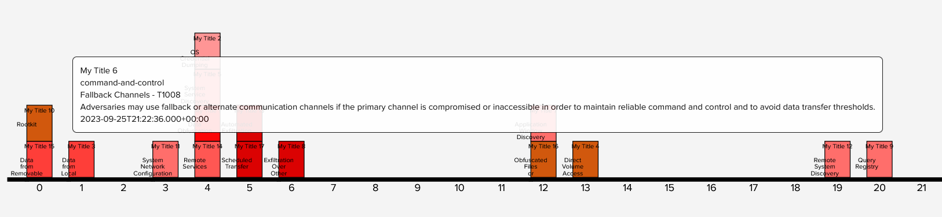
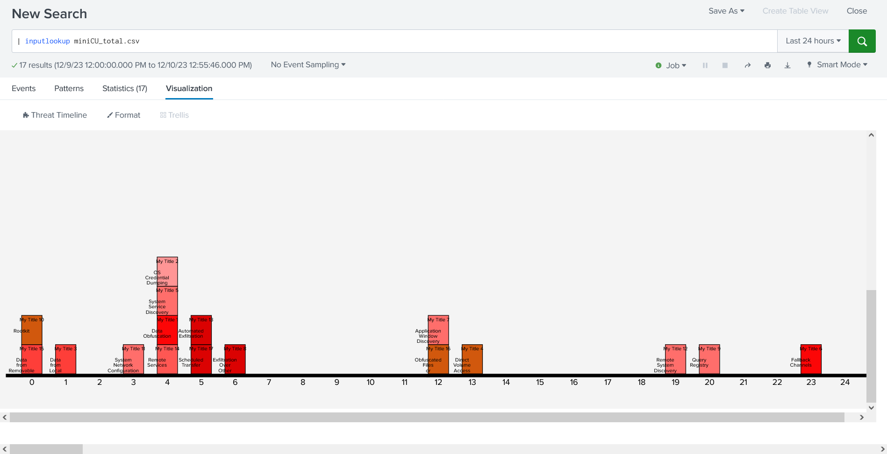
The Prototype: Timeline View

Slide 10
Global Impacts Expected:
Splunk is a widely used monitoring and visualization tool across many industries.
We will be publishing our product as an application on Splunkbase.
This will allow for other cybersecurity professionals to utilize our product.

Slide 11
Thank you!

